Slide 1


A new Animal Health Strategy
for the European Union (2007-2013) where
“Prevention is better than cure”

Slide 2
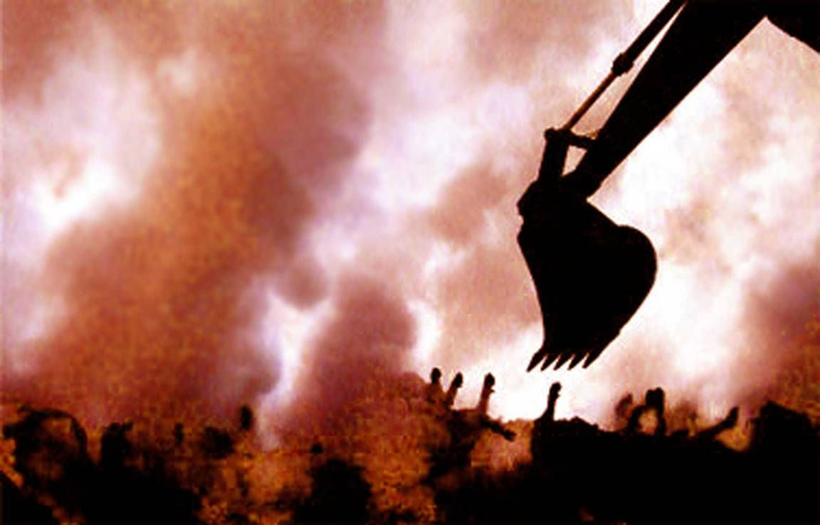
“I haven't got
the heart to go back
into farming”
Philip Board,
Clarence Farm near Axminster
in Devon, UK, after the
foot-and-mouth outbreak

Slide 3
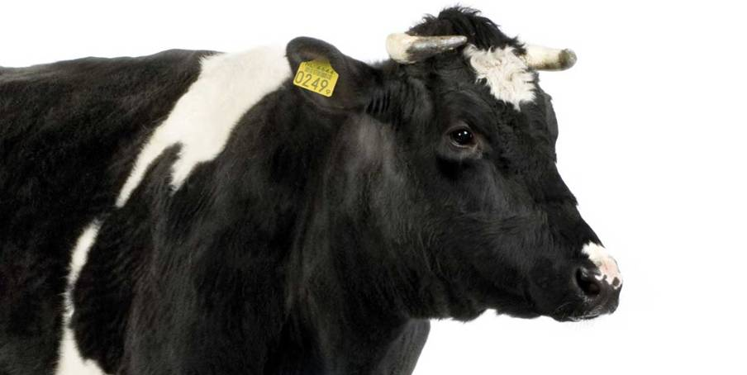
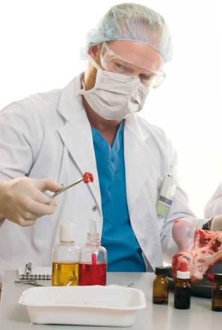
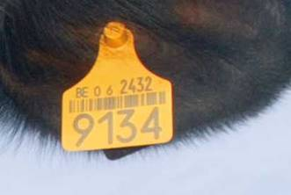
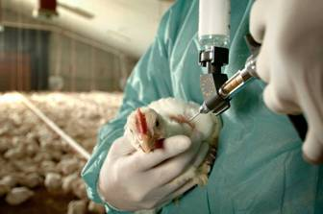
What’s been done

Slide 4
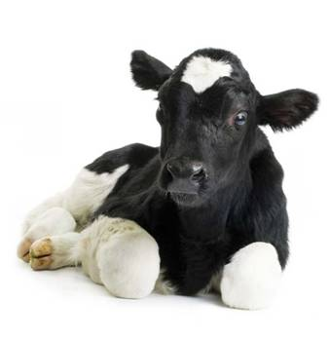
Example: BSE in Europe
37 300 positive BSE cases
24 476 animals tested positive
for BSE
Partial feed ban
General principles of the Food Law
(including safety, responsibility, traceability)
2 167
cases
Total
feed
ban
865
animals tested positive
for BSE
320
cases
1992
1994
2001
02
2004
2006

Slide 5
Why a new
Animal Health Strategy?
New challenges (emerging diseases, outbreaks of eradicated diseases, climate change).
Increased volume of trade in live animals and animal products.
Enlargement of the EU.
Science, technology and our institutional framework have evolved substantially.
Better use of the available resources, including financial tools.

Slide 6
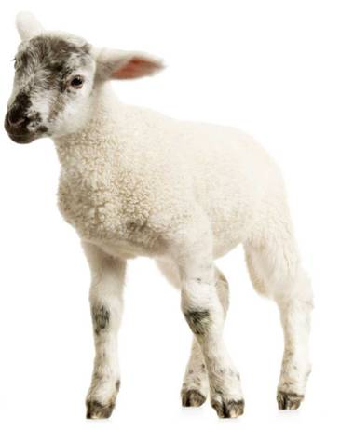
The new Community Animal Health Policy
Goals
> High level of public
health and food safety.
  Also:
> Support farming and
rural economy.
> Improve economic growth/cohesion/competitiveness.
> Promote sustainable farming
practices and animal welfare.

Slide 7
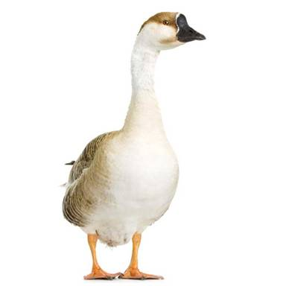
“Prevention is better than cure”
Investment in prevention
Direct and indirect costs
€
Reactive
approach “cure”
€
Proactive
approach “prevention”
€
€

Slide 8
Action Plan Overview
Action Plan of the New Animal Health Strategy
Underlying principles:
Partnership and Communication
Pillar 1
Prioritisation
of
EU intervention
Pillar 2
A modern
EU animal
health legal
framework
Pillar 3
Improve prevention, crisis preparedness
Pillar4
Science, Innovation and Research

Slide 9
Underlying Principles:
Partnership and Communication
Partnership
  Participation of all involved in animal health (NGOs, consumers and governments) as well as interested citizens.
  Stakeholders to give input as well as take responsibility.
  Establish an “Animal Health Advisory Committee”.

Slide 10

Underlying Principles:
“Animal Health Advisory Committee”
A working group of the “Advisory Group on the Food Chain and Animal and Plant Health”
Membership:
  Chief Veterinary Officers
  Representatives of European associations
  Not closed or limited in membership
  Experts and interested parties invited to (temporarily) join the group when there are crises (e.g. disease outbreaks)

Slide 11

Underlying Principles:
Communication
Clarity and transparency when communicating with consumers and stakeholders.
Participation
  Participation in international or national events.
  Developing relationships with the media and non-governmental organisations.
Communication material
  Improving websites to include comprehensive and relevant information for all interested parties
  checklists, manuals and a forum for Q&A
Annual reporting on the strategy’s progress and wider communication of policies and initiatives.

Slide 12
Action Plan of the New Animal Health Strategy
Underlying principles:
Partnership and Communication
Pillar 1
Prioritisation
of
EU intervention
Pillar 2
A modern
EU animal
health
framework
Pillar 3
Improve prevention, crisis preparedness
Pillar4
Science, Innovation and Research

Slide 13
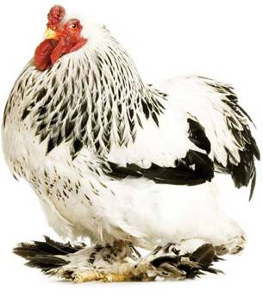
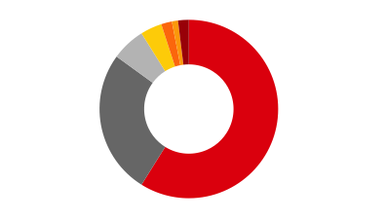
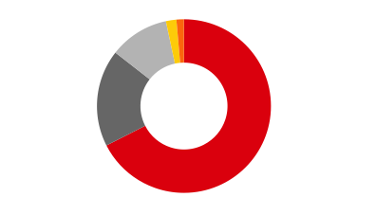
Pillar 1
Defining Priorities
Breakdown of veterinary emergency
funds payments (1997-2005)
BE 1%
DE 2%
Others 1%
BT 19.6
Others 12.6
ES 4%
AI 109.7
IT 6%
CSF 178.7
NL 26%
FMD 668.7
UK 59%
Per country
(% of total)
Per livestock disease
(million €)
Source: Evaluation of the CAHP: Final Report

Slide 14
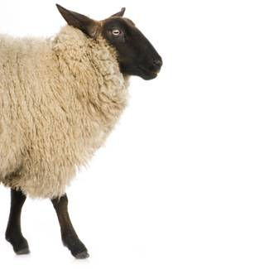
Pillar 1
Defining Priorities
Profiling and categorisation of biological and chemical risks according to level of relevance
Agreement on the acceptable level of risk
Setting of:
  Priorities
  Quantifiable targets
  Performance indicators
  Resources to be committed

Slide 15
Participation of operators in cost-sharing schemes has to be compulsory
Participation of operators in cost-sharing schemes could be voluntary
Public relevance of disease
Very high
High
Moderate
Low
None
Need for EU coordinated action
Total public contributions (EU & MS)
Ratio EU:MS Financing
80%
60%
40%
20%
0%
Very high
Disease A
Disease B*
70:30
High
50:50
Disease C
Disease D*
Moderate
30:70
Low
0:100
* Spread of disease cannot be prevented by proper bio-security measures of operators

Slide 16
Action Plan of the New Animal Health Strategy
Underlying principles:
Partnership and Communication
Pillar 1
Prioritisation
of
EU intervention
Pillar 2
A modern
EU animal
health
framework
Pillar 3
Improve prevention, crisis preparedness
Pillar4
Science, Innovation and Research

Slide 17
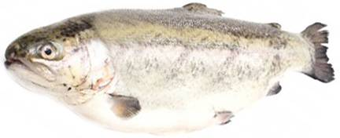
Pillar 2
A Modern Legal Framework
> Replace the existing series of linked and interrelated policy actions by a single policy framework.
> Develop efficient cost and responsibility sharing schemes.
> Converge as far as possible with
the international recommendations,
standards and guidelines of the OIE/Codex.

Slide 18
Pillar 2
A Modern Legal Framework
2.1 A single and clearer regulatory framework
Define and integrate common principles and requirements
Have more effective procedures
Develop efficient cost and responsibility-sharing schemes
Transfer of funds from low-risk to high-risk areas

Slide 19
Pillar 2
A Modern Legal Framework
2.3 Community legislation and international standards
Improve convergence with international standards.
Promote EU standards in the OIE/Codex.
Encourage other members to improve the alignment of their legislation with international standards and defend the EU position.
Community to become a member of OIE.

Slide 20
Action Plan of the New Animal Health Strategy
Underlying principles:
Partnership and Communication
Pillar 1
Prioritisation
of
EU intervention
Pillar 2
A modern
EU animal
health
framework
Pillar 3
Improve prevention, crisis preparedness
Pillar4
Science, Innovation and Research

Slide 21
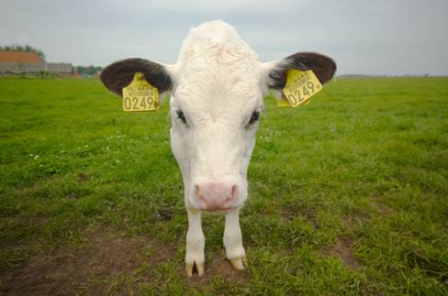
Pillar 3
Threat prevention, surveillance and crisis preparedness
What is it?
Identifying problems before they take hold, and being ready to manage outbreaks and crises.

Slide 22
Pillar 3
Threat prevention, surveillance and crisis preparedness
3.1 On-farm bio-security measures
Keep diseases out of populations, herds, or groups and limit the spread of disease within the herd by isolation, regulation of movements, correct use of feed, cleaning and disinfecting etc.
Guidelines/production systems and species (e.g. intensive production, extensive production, high-density area).
Provision of funding to finance and promote on-farm bio-security.
Means of rating holdings and supporting the development of the responsibility and cost sharing scheme.

Slide 23
Pillar 3
Threat prevention, surveillance and crisis preparedness
3.2 Identification and tracing
TRACES: a single portal for all veterinary matters.
Interoperability of national identification databases.
Introduction of procedures for electronic identification and certification.
Implementation of a single, integrated electronic system with a unified database.

Slide 24
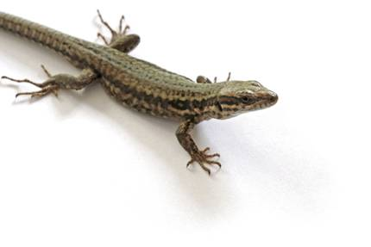
Pillar 3
Threat prevention, surveillance and crisis preparedness
3.3. Better border
bio-security
Revision of the current legislation (risk-based approach to border inspections).
Optimise coordination of agencies/services regulating imports.
Make travellers aware of restrictions and of their responsibilities.
Help third countries combat threats at the source and provide assistance.

Slide 25
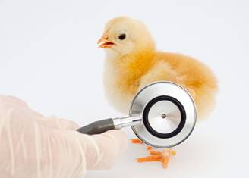
Pillar 3
Threat prevention, surveillance and crisis preparedness
3.4 Veterinary Surveillance
Improve surveillance prioritisation (categorisation)
Improve data collection, risk analysis and information
Provide funding:
  to support epidemiosurveillance
  to maintain the EU diagnostic capability
  to provide appropriate training

Slide 26
Pillar 3
Threat prevention, surveillance and crisis preparedness
3.5 Emergency Preparedness
Initiative to improve EU preparedness against major threats.
Possibility to make use of the EU Solidarity Fund (emergency) or creation of a similar budget line.
Define specific scientific and regulatory approaches for the authorisation of veterinary vaccines.

Slide 27
Action Plan of the New Animal Health Strategy
Underlying principles:
Partnership and Communication
Pillar 1
Prioritisation
of
EU intervention
Pillar 2
A modern
EU animal
health
framework
Pillar 3
Improve prevention, crisis preparedness
Pillar4
Science, Innovation and Research
Notes:
Last but not least, the fourth pillar consists in science, innovation and research.

Slide 28

Pillar 4
Science, Innovation & Research
4.1 Science
Strengthen the collaboration between European agencies and national bodies
Review and where necessary extend the activities of the Community Reference Laboratories (evaluation)

Slide 29
Pillar 4
Science, Innovation & Research
4.2 Innovation & Research
Define a research action plan
  prioritise animal-related threats and identify the “gaps” in existing control tools/medicines.
Appropriate level of funding.
Support for research in developing countries through international cooperation.

Slide 30
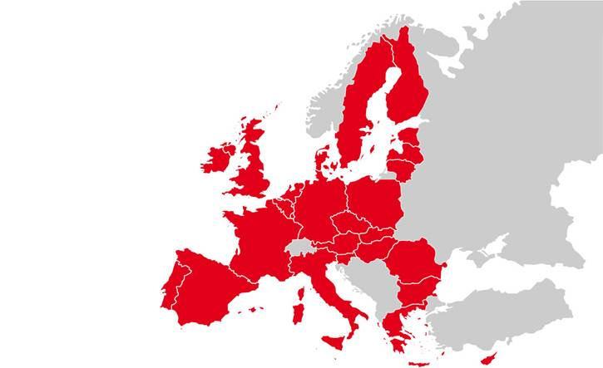
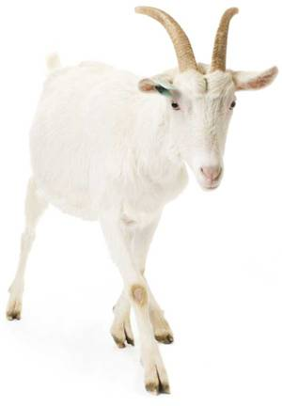
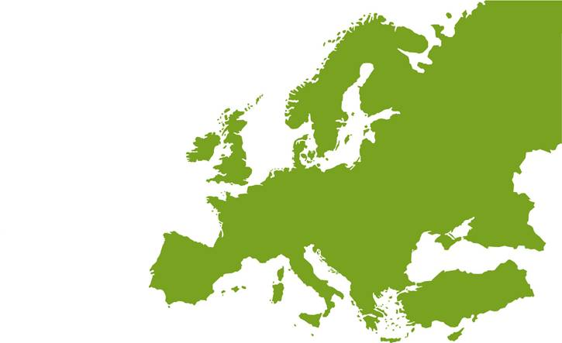
Conclusion
A collaborative
Approach

Slide 31
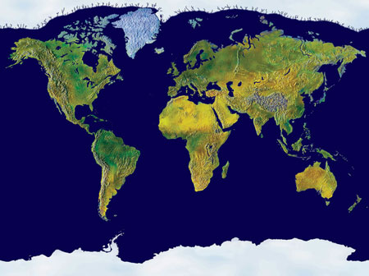
Conclusion
A collaborative
Approach
THANK YOU!

